Slide 1
Ganesh. R
Final Project
3/21/2024 Annual Review

Slide 2
DCGAN For Anime Face Generations
Deep Convolutional Generative Adversarial Network (DCGAN) is a type of AI that learns to create anime faces by playing a game. The "generator" tries to make fake faces, and the "discriminator" tries to spot the fakes. As they compete, the generator gets better at making realistic faces, resulting in lifelike anime faces being generated.
3/21/2024 Annual Review

Slide 3

Agenda
Problem Statement
Project Overview
End User
My Solution and Its Value Proposition
The Wow in Your Solution
Modeling
Result
3/21/2024 Annual Review

Slide 4

PROBLEM STATEMENT
The Problem aims to develop a Generative Adversarial Network (GAN) capable of generating good resolution anime faces resembling those Anime Faces dataset. The Anime Faces dataset consists of 64x64 resized images of anime faces (up to 21,551 images). The objective is to create a GAN that can produce good resolution images resembling these Anime Faces dataset.
3/21/2024 Annual Review

Slide 5

PROJECT OVERVIEW
. Dataset: We have a treasure trove of 21,551 anime faces collected from getchu.com. These images are preprocessed and resized to a convenient 64x64 resolution.
Implementation Steps: Import Libraries: We summon TensorFlow, OpenCV and Matplotlib. Constants and Helpers: We wield constants and functions for image handling. Convolution and Deconvolution Blocks: These magical Building blocks shape our generator and discriminator. Training: DCGAN model learns to conjure anime faces from random noise.
3/21/2024 Annual Review

Slide 6

WHO ARE THE END USERS?
End users of DCGAN anime faces generation are
Anime Fans
Game developers
Animation studios
Researchers and Academics
Anime Enthusiasts and Collectors
They use these AI-generated faces for art, gaming, animation, research and personal interests.
3/21/2024 Annual Review

Slide 7
YOUR SOLUTION AND ITS VALUE PROPOSITION
The solution involves utilizing DCGAN (Deep Convolutional Generative Adversarial Network) technology for generating anime faces. This technology leverages deep learning techniques to create realistic and diverse anime-style faces.
Value Proposition:
High-Quality Output
Efficiency
Versatility
Customization
3/21/2024 Annual Review

Slide 8
THE WOW IN YOUR SOLUTION
Unleashing AI Magic: By leveraging DCGAN technology, our solution transforms ordinary data into mesmerizing and lifelike anime faces, showcasing the awe-inspiring capabilities of artificial intelligence.
Limitless Creativity: our solution empowers users to unleash their creativity in art, gaming, animation, and research like never before.
Revolutionizing Industries: Whether it's captivating audiences in entertainment or fueling groundbreaking research,
3/21/2024 Annual Review
8

Slide 9
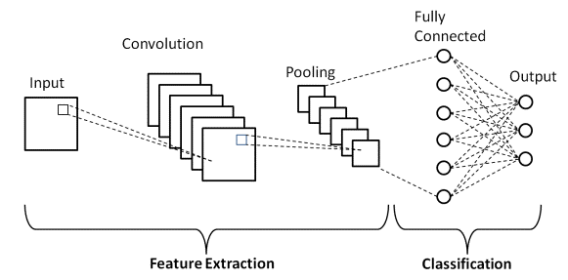
MODELLING
Modeling in DCGAN-generated anime faces refers to the process of training and refining the architecture to generate realistic and diverse anime-style faces.
3/21/2024 Annual Review
9

Slide 10
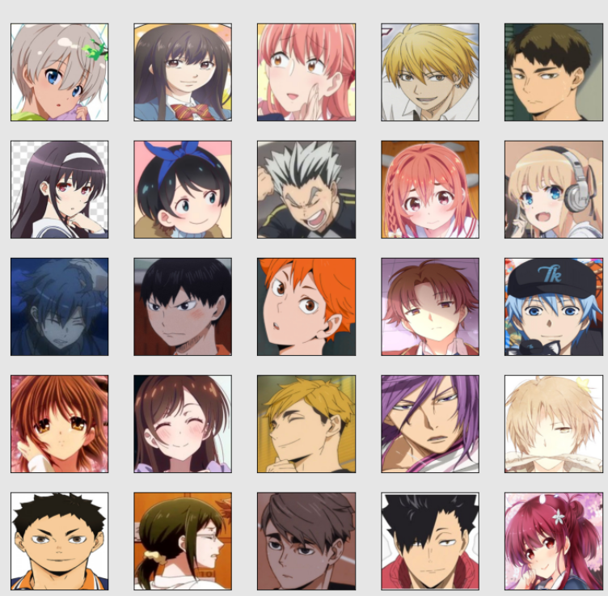
OUTPUT

Slide 11
APPLICATION
The application of the Deep Convolutional Generative Adversarial Network (DCGAN) project for generating anime faces can be seen in various creative and practical domains:
Anime Character Creation
Content Creation
Personalized Avatars and Characters
Artificial Intelligence and Creativity
Educational and Research Purposes
Entertainment and Fan Communities

Slide 12
RESULT
Our project effectively demonstrates the power of Generative Adversarial Networks (GANs) in generating realistic anime faces, showcasing their remarkable capabilities in creating diverse and engaging visual content.
Through meticulous training and fine-tuning of the DCGAN architecture, we have achieved impressive results in terms of image quality, style variation, and artistic appeal.
12

Slide 13
REFERENCES
https://www.tensorflow.org/
https://keras.io/
https://numpy.org/
https://matplotlib.org/

